Slide 1
Palm Sunday Matthew 21 vv1-11 Matthew 21 vv12-16

Slide 2
Now when they drew near Jerusalem, and came to Bethphage, at the Mount of Olives, then Jesus sent two disciples, ² saying to them, “Go into the village opposite you, and immediately you will find a donkey tied, and a colt with her. Loose them and bring them to Me. ³ And if anyone says anything to you, you shall say, ‘The Lord has need of them,’ and immediately he will send them.” ^{4 [b]}All this was done that it might be fulfilled which was spoken by the prophet, saying: ⁵ “Tell the daughter of Zion, ‘Behold, your King is coming to you, Lowly, and sitting on a donkey, A colt, the foal of a donkey.’ ”

Slide 3
⁶ So the disciples went and did as Jesus commanded them. ⁷ They brought the donkey and the colt, laid their clothes on them, and set Him on them. ⁸ And a very great multitude spread their clothes on the road; others cut down branches from the trees and spread them on the road. ⁹ Then the multitudes who went before and those who followed cried out, saying:
“Hosanna to the Son of David! ‘Blessed is He who comes in the name of the Lord!’ Hosanna in the highest!”
¹⁰ And when He had come into Jerusalem, all the city was moved, saying, “Who is this?”
¹¹ So the multitudes said, “This is Jesus, the prophet from Nazareth of Galilee.”

Slide 5
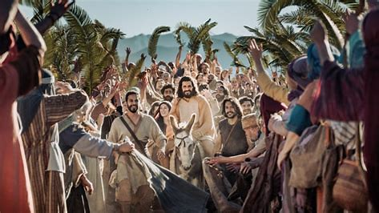
Fulfilling Prophecy
“Rejoice greatly, O daughter of Zion! Shout, O daughter of Jerusalem! Behold, your King is coming to you; He is just and having salvation, Lowly and riding on a donkey, A colt, the foal of a donkey.

Slide 7
Just, Salvation but Humble?
A Just Ruler - Righteous
Bringing Salvation – “Hosanna”
The Humility, not triumphalism -
“That’s what we bestow on Him”

Slide 9
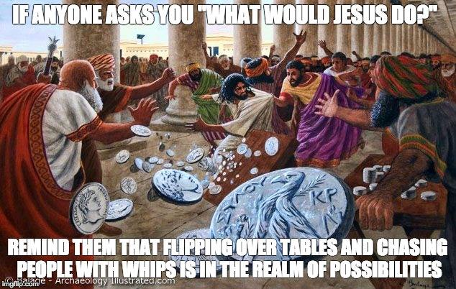
A change of Pace, a change of style
Outrage – all sides

Slide 10
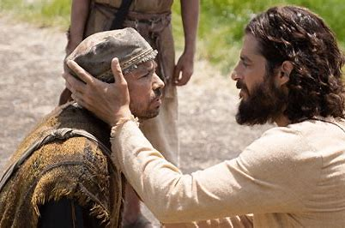
A change of Pace, a change of style
Compassion for the sick

Slide 11
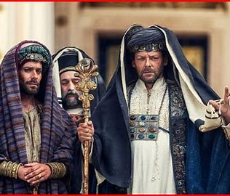
A change of Pace, a change of style
Response of Authority

Slide 13
Conclusion
“Palm Sunday was a triumph, but it was just the start of a greater one”

